Slide 1
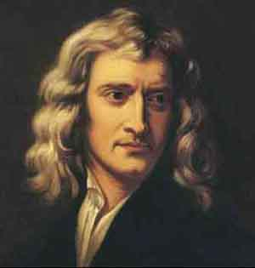
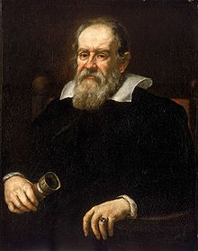
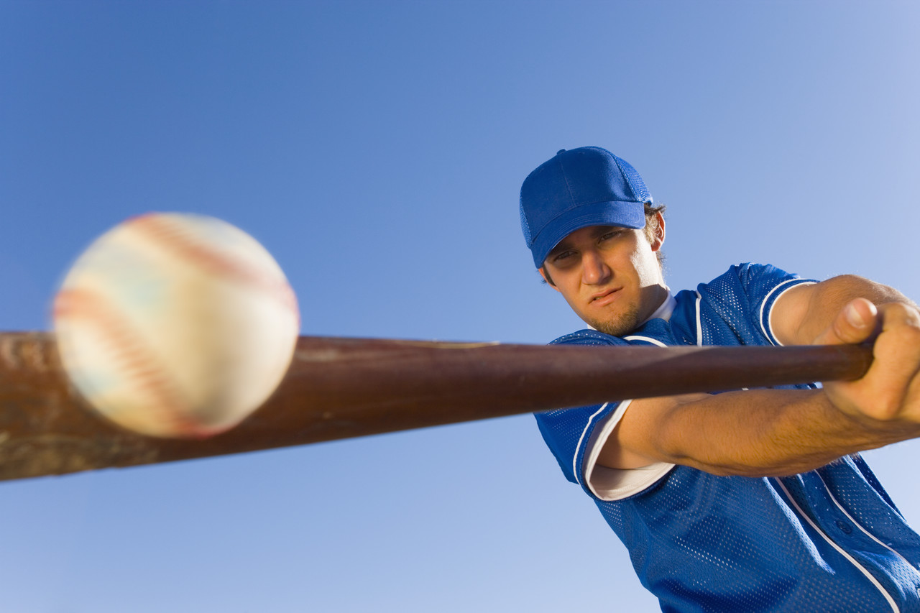
Forces and
Newton’s First Law
Notes:
Forces and Newton’s First Law Presentation, TeachEngineering.org
Image sources:
A man hitting a baseball: Microsoft clipart http://office.microsoft.com/en-us/images/results.aspx?qu=baseball&ex=1#ai:MP900430569|
A portrait of Isaac Newton: 1689 Sir Godfrey Kneller, Wikimedia Commons
http://commons.wikimedia.org/wiki/File:GodfreyKneller-IsaacNewton-1689.jpg
A portrait of Galileo Galilei: 1636 Justus Sustermans, Wikimedia Commons http://commons.wikimedia.org/wiki/File:Justus_Sustermans_-_Portrait_of_Galileo_Galilei,_1636.jpg

Slide 2
Inertia is an object’s resistance to changing its motion
What is inertia?
white board marker
hoop
bottle
Notes:
For this class demo, balance a hoop on the top of a weighted bottle, and the marker on the hoop, as shown in the drawing.
Ask students: What do you think will happen when I knock the hoop from the bottle?
After student discussion and predictions, quickly knock the hoop from its location between the bottle and the marker. If done correctly, the marker falls straight into the bottle.
This demonstrates inertia; the marker resists changing direction when the hoop is knocked away.
Alternatively, show an online video of the same demo, such as:
Home Experiment: Newton's First Law/Law of Inertia (55-second video; good for practicing) at https://www.youtube.com/watch?v=uOSBC0SXVR4
Conceptual Physics - Inertia Hoop Demo (2:47-minute video; good for students) at https://www.youtube.com/watch?v=Qu9wEzEHw0A

Slide 3
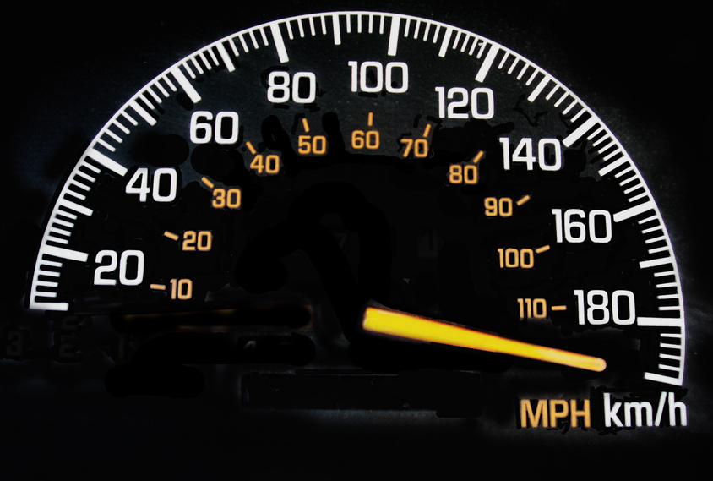
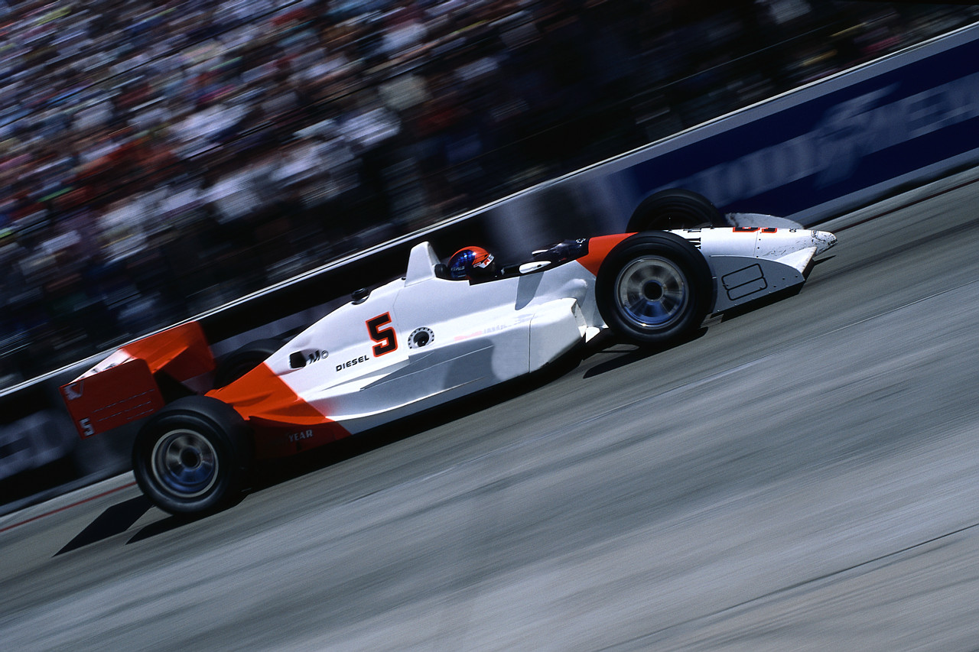
Velocity is speed and direction
In what direction is the racecar traveling?
What is the velocity of the racecar?
distance traveled
Review: What is speed?
speed =
time
Acceleration is a change in velocity
Notes:
This slide is a primer on speed, velocity and acceleration.
Speed is distance traveled divided by time.
Example: if a racecar is traveling at 120 mph, how much time does it take to travel one mile?
Velocity is speed and the direction of travel.
Direction can be a compass direction (N, SE, etc.), up or down, or positive or negative (as in the integer number line).
In this case, looking at the compass, the racecar is traveling east, so its velocity is 120 miles per hour to the east.
(Play around with variations on this scenario, changing direction and speedometer display as desired.)
Next, introduce positive and negative as directions. In this case, the racecar velocity is 120 mph in the positive direction. If the driver shifted into reverse, the car’s velocity would be 120 mph in the negative direction or -120 mph.
Use the speedometer to introduce acceleration as a change in velocity. Imagine the racecar initially at rest, not moving at all, then the driver presses the gas pedal and the car begins to move in the positive direction. The change in velocity is the acceleration.
Have you ever heard someone say that a really powerful car can “go zero to 60 mph in (for example) 4 seconds”? This description is a measure of acceleration.
Also, remember that since velocity consists of both speed AND direction, acceleration might entail changing the speed OR the direction OR both.
Run through some practice examples. For example: “If you are walking north at 3 miles an hour, is that your speed or your velocity?” (Answer: Velocity)
Image sources:
A standard compass showing the four cardinal directions: Microsoft clipart http://office.microsoft.com/en-us/images/results.aspx?qu=compass&ex=1#ai:MC900329243|
A speedometer dial: Microsoft clipart http://office.microsoft.com/en-us/images/results.aspx?qu=speedometer&ex=1#ai:MP900448291|
A formula one car on a racetrack: Microsoft clipart http://office.microsoft.com/en-us/images/results.aspx?qu=formula+one&ex=1#ai:MP900399388|

Slide 4

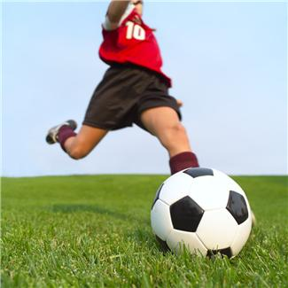
A force is a push, pull or twist
Examples of contact forces
Applying a force can change an object’s velocity.
accelerate
Applying a force can cause an object to _________.
Notes:
A force is a push or pull upon an object resulting from the object's interaction with another object. Whenever two objects are interacting, then some force is acting upon each of the objects. When the interaction stops, the two objects no longer experience any force between them. Forces only exist as a result of interactions.
These 3 images all depict contact forces.
Image sources:
A man playing field hockey: 2005 Michelangelo-36, Wikimedia Commons http://commons.wikimedia.org/wiki/File:HOCKEY_ARGENTINA_PAKISTAN.jpg
A girl kicking a soccer ball: Microsoft clipart http://office.microsoft.com/en-us/images/results.aspx?qu=kick&ex=1#ai:MP900422162|mt:2|
A body tugging a rope: Microsoft clipart

Slide 5

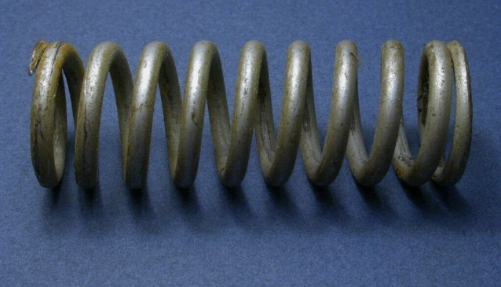
Types of Forces
Contact forces: interactions between objects that touch
Non-contact forces: attract or repel, even from a distance
magnetic force
applied force
spring force
electric force
drag force
gravitational force
frictional force
Notes:
Introduce students to the different types of forces through simple demonstrations.
Distinguish between contact and non-contact forces.
Show that different types of forces exist in each category.
Give brief definitions of each type of force (direct students to write these definitions in their notebooks) and perform a simple demonstration of each one.
Image sources:
A man hitting a baseball: Microsoft clipart http://office.microsoft.com/en-us/images/results.aspx?qu=baseball&ex=1#ai:MP900430569|
A metal spring: 2004, Jean-Jacques MILAN, Wikimedia Commons http://en.wikipedia.org/wiki/File:Ressort_de_compression.jpg
A cartoon parachute an man; Microsoft clipart http://office.microsoft.com/en-us/images/results.aspx?qu=parachute&ex=1#ai:MC900370246|
A cartoon girl slipping on ice: Microsoft clipart http://office.microsoft.com/en-us/images/results.aspx?qu=slip&ex=1#ai:MC900366436|
A “U” magnet: Microsoft clipart
A cartoon atom: Microsoft clipart http://office.microsoft.com/en-us/images/results.aspx?qu=magnet&ex=1#ai:MC900340404|
An apple falling from an apple tree onto a man in a suit: Microsoft clipart http://office.microsoft.com/en-us/images/results.aspx?qu=apple+falling&ex=1#ai:MC900198175|

Slide 6
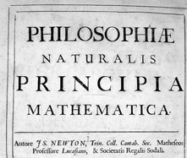
Deciphering Newton’s First Law
“Every body persists in its state of being at rest or of moving uniformly straight forward, except insofar as it is compelled to change its state by force impressed.”
—Sir Isaac Newton
Principia Mathematica (1687)
Write: In your own words, what does this mean?
Unless an unbalanced force acts on an object,
An object at rest stays at rest
An object in motion stays in motion
Isaac Newton, 1642-1727
Notes:
Make sure students do not confuse “every body” with “everybody.” Clarify that Newton wrote “every body,” meaning “every object.”
This slide brings in the Common Core.
Image sources:
The cover page of Newton’s book, Naturalis Principia Mathematica: 1687 Wikimedia Commons http://commons.wikimedia.org/wiki/File:Prinicipia-title.png
A portrait of Isaac Newton: 1689 Sir Godfrey Kneller, Wikimedia Commons
http://commons.wikimedia.org/wiki/File:GodfreyKneller-IsaacNewton-1689.jpg

Slide 7
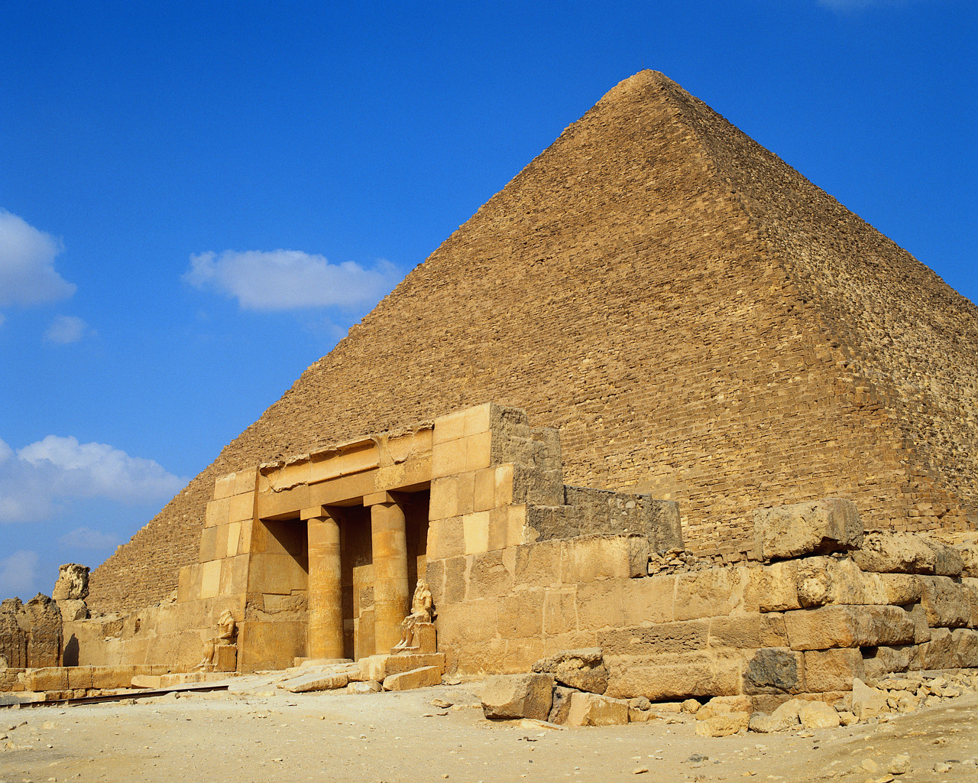
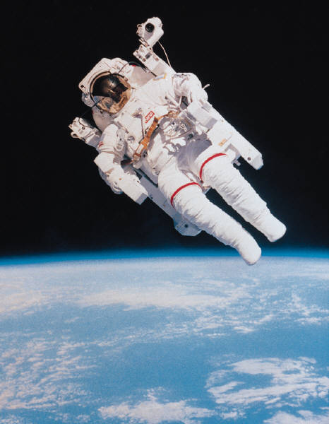
Newton’s First Law of Motion
Objects in motion stay in motion and objects at rest stay at rest—unless acted upon by an unbalanced force.
Also called the “law of inertia.”
Notes:
An object only accelerates if an unbalanced force acts on it (net force ≠ 0). If the forces acting on an object are balanced (or no forces are acting on the object), then the object maintains its velocity (if non-zero).
Reinforce the concept with examples; explain how each image on this slide illustrates this physical law.
-The pyramid is a massive object that does not move.
-In space, when astronauts move, they continue moving (think of footage from the international space station).
-If a biker’s front wheel hits a barrier (maybe a log), s/he will fly over the handlebars.
(optional) Discuss the invisible bike helmet, a cool engineering invention, and show a 3:46-minute video about it; the video can be interpreted to demonstrate Newton’s first law in the event of a bike crash; VIDEO at https://www.youtube.com/watch?v=CMAhptqk-4Q
Image sources:
Ancient pyramid: Microsoft clipart
A cartoon boy on a bike: Microsoft clipart
An astronaut in space with Earth in background: Microsoft clipart http://office.microsoft.com/en-us/images/results.aspx?qu=astronaut&ex=1#ai:MP900178714|mt:2|

Slide 8

Unbalanced Forces
drag (air resistance)
3 Newtons
What two forces are acting upon the umbrella?
7 Newtons
weight
(gravitational force)
Notes:
Provide an elementary explanation of vectors: Begin with a discussion of the integer number line, which students have seen in math class. Then orient that line vertically with positive pointing down. It may be advanced, but the idea to communicate is that forces are additive.
Move into a discussion of air resistance and what would happen in its absence. In this case, if two objects are dropped from the same height at the same time, they hit the ground at the same time. The video of an Apollo astronaut dropping a feather and hammer on the moon is an excellent visual extension to show students.
https://www.youtube.com/watch?v=5C5_dOEyAfk
Image sources:
A blue umbrella: Microsoft clipart http://office.microsoft.com/en-us/images/results.aspx?qu=umbrella&ex=1#ai:MC900432545|

Slide 9
Galileo Galilei: “I found it first!”
I call it “inertia.”
Inertia is an object’s resistance to changing its motion.
I wrote:
“A body moving on a level surface will continue in the same direction at constant speed unless disturbed.”
Sure, Newton stated it more thoroughly, but they don’t call me “the father of modern physics”
for nothing!
Galileo Galilei, 1564-1642
Notes:
Image source:
A portrait of Galileo Galilei: 1636 Justus Sustermans, Wikimedia Commons http://commons.wikimedia.org/wiki/File:Justus_Sustermans_-_Portrait_of_Galileo_Galilei,_1636.jpg

Slide 10

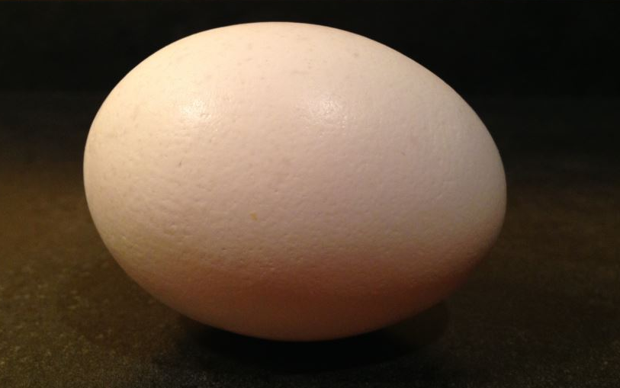
Egg Inertia Puzzle
What’s different about these two eggs?
Notes:
Simple demo: spin both a hardboiled egg and a raw egg. Stop each with your finger, then quickly let go. The hardboiled egg remains still, while the raw egg spins again (the yolk keeps spinning inside the shell).
Explain to students that the (unseen, soft) yolk continued to rotate.
Image sources:
Pondering man: Microsoft clipart http://office.microsoft.com/en-us/images/results.aspx?qu=thinker&ex=1#ai:MC900048773|
A white-shelled egg (used twice): 2014 Denise W. Carlson, College of Engineering, University of Colorado Boulder; used with permission

Slide 11
Concept Review
1. An object’s resistance to changing its motion is called ______.
2. Velocity measures ______and ________.
3. A change in velocity is called ___________.
4. A _____ is a push, pull or twist.
5. Kicking a ball is an example of a __________ force.
6. Newton’s first law of motion: Objects in motion will stay in motion and objects at rest will stay at rest, unless acted on by __________________.
inertia
speed
direction
acceleration
force
contact
an unbalanced force
Notes:
Review slide for Day 1 material (lesson 1).
Next, administer the exit ticket and homework assignment that correspond to this material.
Day 2 begins with slides reviewing the material from Day 1. The new Day 2 material begins with the slide on Newton’s second law.

